Slide 1







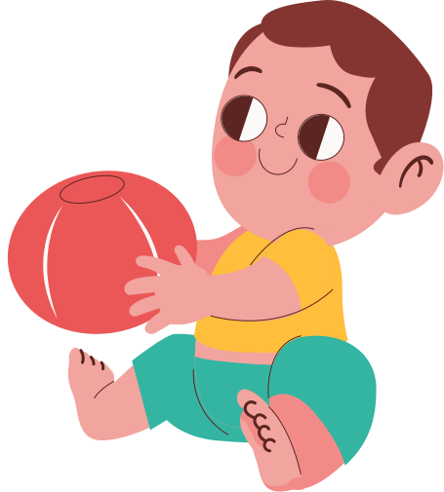


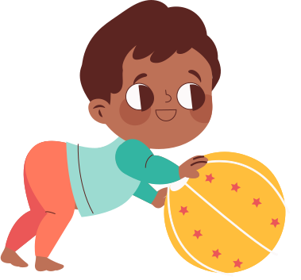


Growing Up
This week’s topic

Slide 2




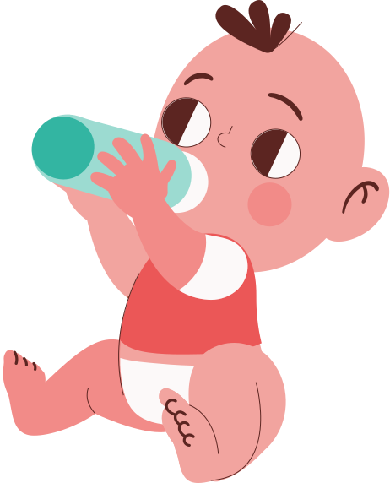




Warm Up
  “What does growing up mean to you?”
  “Do you feel different now than 2 years ago?”

Slide 3



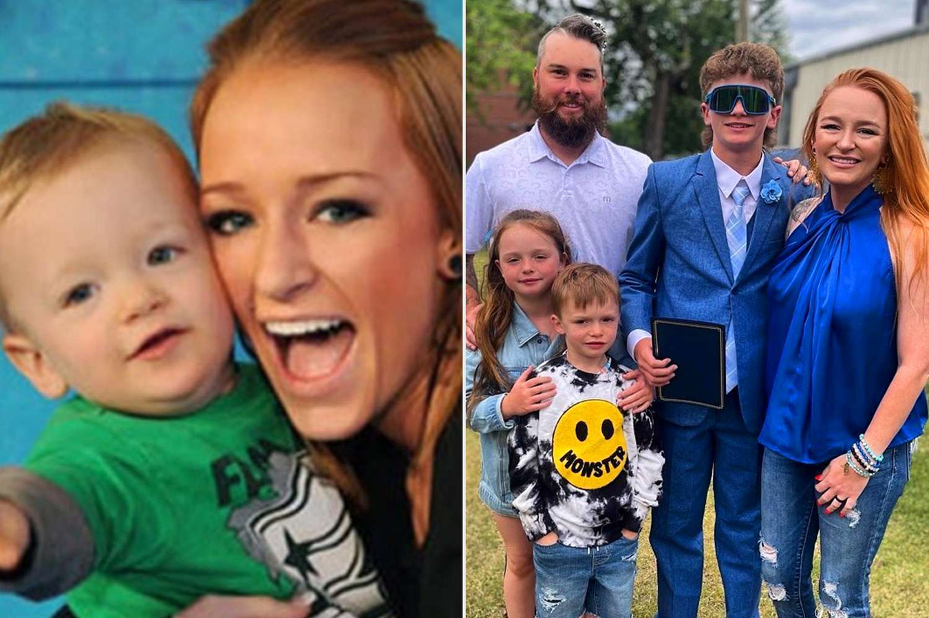





How are they different?

Slide 4






















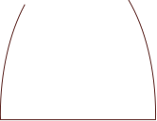













Vocabulary

Slide 5





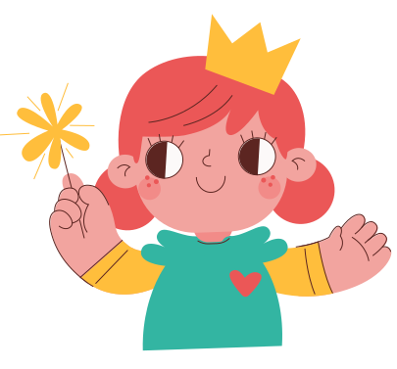
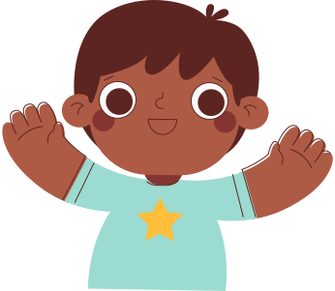

Grow up (phrasal verb)
— to gradually become an adult.
(Example: "What do you want to be when you grow up?")
Become independent (verb phrase)
— to start doing things for yourself without needing help from other people.
(Example: "Children need support as they become independent.")

Slide 6





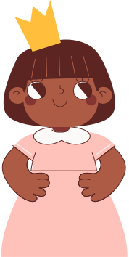
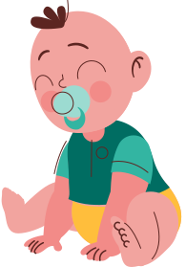
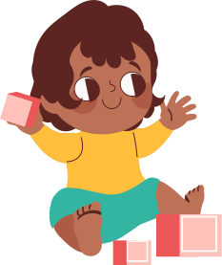
Make decisions (verb phrase)
— to choose something after thinking about the different possibilities.
(Example: "He finds it hard to make decisions quickly.")
Responsibility (noun)
— a duty to deal with something or take care of somebody/something, so that you may be blamed if something goes wrong.
(Example: "Parents have a responsibility to protect their children.")
Future goals (noun phrase)
— things that you want to achieve later in your life.
(Example: "Setting future goals helps people stay motivated.")

Slide 7





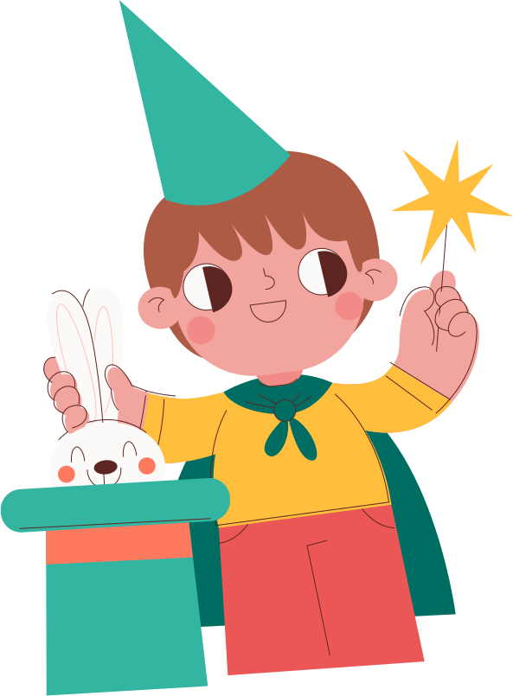





Game

Slide 8





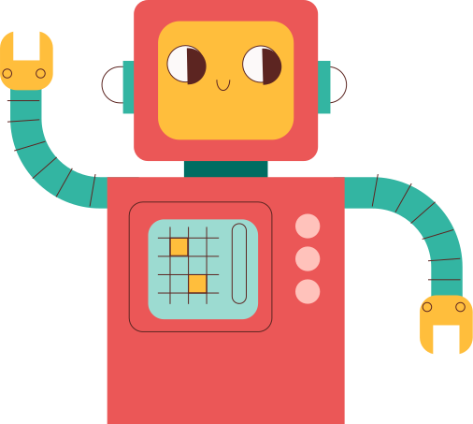
Gameshow Quiz
Instruction for Teachers: Open the web below, choose Gameshow quiz mode and copy the provided prompt to proceed the game.
https://edtechcorner.com/apps/text2activities/index.html
Prompts:
to gradually become an adult. |Grow up|Become independent|Make decisions|Responsibility|Teenager|Future goals
to start doing things for yourself without needing help from other people. |Grow up|Become independent|Make decisions|Responsibility|Teenager|Future goals
to choose something after thinking about the different possibilities. |Grow up|Become independent|Make decisions|Responsibility|Teenager|Future goals
a duty to deal with something or take care of somebody/something, so that you may be blamed if something goes wrong. |Grow up|Become independent|Make decisions|Responsibility|Teenager|Future goals
a person who is between 13 and 19 years old. |Grow up|Become independent|Make decisions|Responsibility|Teenager|Future goals
things that you want to achieve later in your life. |Grow up|Become independent|Make decisions|Responsibility|Teenager|Future goals

Slide 9






What do you want to be when you grow up?
Instruction for Teachers: Click Enable Editing to see the Contents
Notes:
https://www.youtube.com/watch?v=RUup841pZrs

Slide 10



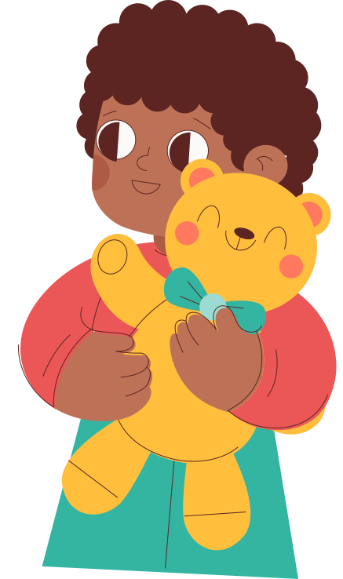



Past, Present, Future
Instructions:
Students prepare short answers to these 3 prompts:
  Past: What were you like when you were younger?
  Present: What is something you can do now that you couldn’t before?
  Future: What do you want to do or be when you grow up?
Activities:
  Model answers with sentence frames:
    “When I was 6, I used to…”
    “Now, I can…”
    “In the future, I want to… because…”

Slide 11




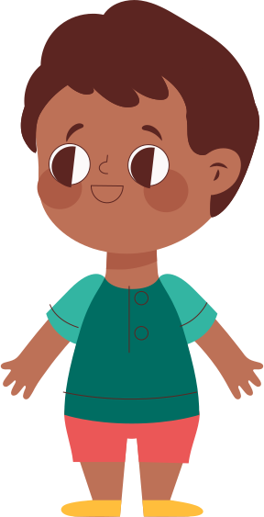
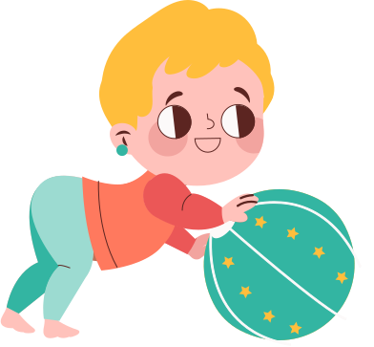

Speaking Game
Would You Rather – Future Edition
Examples:
  “Would you rather be a teacher or a doctor?”
  “Would you rather live in the city or the countryside when you grow up?”
  Students answer and give reasons.

Slide 12





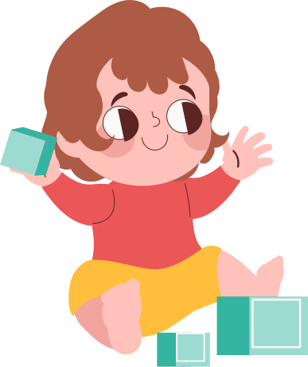

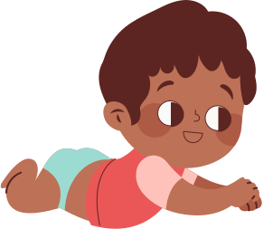


Thanks!
See ya!

